Slide 1
All about Vikings
By JOSEPH WHITAKER

Slide 2
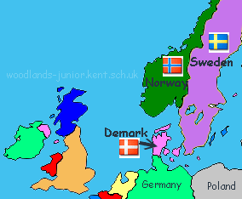
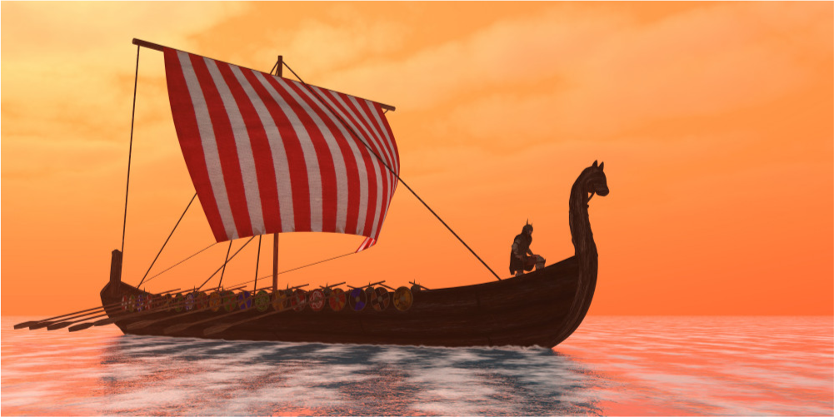
Where the Vikings came from
Interesting fact
Norsemen means 'people from the North’.
The Vikings came from the three countries in Scandinavia (in Northern Europe).
Norway was very hilly.
Sweden was covered in forests.
Denmark had a lot of sandy soil
.

Slide 3
Their longships could sail in shallow water which meant they could travel up rivers as well as across the sea.
Viking craftsmen made beautiful objects out of wood, metal and bone; Viking women were skilful weavers, produced fine, warm textiles.

Slide 4
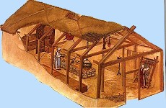
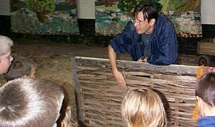
All about Viking Houses
Viking houses were often one room homes with a cooking fire in the middle. The smoke escaped through a hole in the roof.
Animals and people lived in the same building. The animals lived in a byre at one end of the house and the people lived at the other.

Slide 5
Vikings Religion
The Vikings worshiped many different Gods and Goddesses.
Their religion was an important part of everyday life.
The three most important Viking Gods
Din - the leader of the gods - god of magic, poetry and war.
Thor (Tor in Scandinavian languages) was the god of thunder.
Thor had iron gloves, a magic belt and a hammer. He was also god of protection. He provided protection from cold hunger, giants and other dangers.
Freyr - god of agriculture and fertility.
Frey was worshipped on a regular basis all through-out the year for future prosperity..
Norse Myths (Sagas)
The Vikings told many stories about gods, giants, trolls and dragons. They were full of magic, adventure, trickery and mischief. They describe people living in Midgard (Middle Earth) and gods and goddesses living in a sky world called Asgard. A beautiful rainbow bridge linked Midgard with Asgard.
Valhalla
The Vikings believed that men who died in battle went to Valhalla (Old Norse Valhöll, "Hall of the slain"). It a great hall where dead heroes feasted with the gods.

