Slide 1
The Reading curriculum -Post RWI
Pollington-Balne CE Primary School – Y2 to Y6

Slide 2
Our reading curriculum is …
Text led
Linked to the wider curriculum
Links to our writing curriculum
Provides opportunities to link to our Christian and British Values
Focused on reading fluency and reading comprehension

Slide 3
Lesson structure
Revisit
Assess
Assess
40 mins
Practice the VIPER
Read the text
Model the VIPER

Slide 4
Vipers at KS1 vs KS2
 | NC Reading Domain
Vocabulary | 1a draw on knowledge of vocabulary to understand texts
Infer | 1d make inferences from the text
Predict | 1e predict what might happen on the basis of what has been read so far
Explain | This is NOT a content domain. Within teaching children should be asked to justify their answers and opinions.
Retrieve | 1b identify / explain key aspects of fiction and non-fiction texts, such as characters, events, titles and information
Sequence | 1c identify and explain the sequence of events in texts
 | NC Reading Domain
Vocabulary | 2a give / explain the meaning of words in context
Infer | 2d make inferences from the text / explain and justify inferences with evidence from the text
Predict | 2e predict what might happen from details stated and implied
Explain | 2f identify / explain how information / narrative content is related and contributes to meaning as a whole 2g identify / explain how meaning is enhanced through choice of words and phrases 2h make comparisons within the text
Retrieve | 2b retrieve and record information / identify key details from fiction and non-fiction
Summarise | 2c summarise main ideas from more than one paragraph

Slide 5
1: Vocabulary
Research has shown a clear correlation between vocabulary size at different ages and later cognitive and social development.
This is usually the focus of the first lesson in the cycle in relation to the chapter or extract for that week.
Vocabulary is displayed and revisited throughout that week and subsequent weeks.

Slide 6
Vocabulary – Selecting books
Educationist Doug Lemov talks about ‘The 5 Plagues of the Developing Reader’ and recommends that children are exposed to all five in order to sufficiently develop vocabulary over time:
Archaic texts (older texts with different vocabulary today)
Nonlinear Time (shifts in time)
Complexity of Narrator (multiple narrators, nonhuman narrators etc.)
Complexity of Plot
Resistant texts (intentionally difficult to understand – think ‘Jabberwocky’)
Staff ensure that a range of texts are read by the children to strengthen this knowledge.

Slide 7
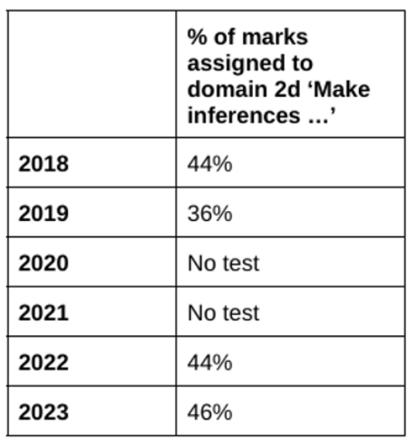
2: Inference Skills
Inference is when we reach an informed assumption based on evidence or reasoning.
When we make inferences while reading, we are using evidence provided by the author to draw our own logical conclusions.
We use the information given in a text to ascertain certain things for ourselves.
This forms the next lesson the teaching sequence; the children are familiar with the language and therefore only have to consider the deeper meaning.

Slide 8
Inference – an example
Quickly putting up his umbrella, Derek splashed through the growing puddles, as all around him the street lights flickered on one after the other, after the other.
Q1. What time of day is it in the text?
Q2. What is the weather doing?

Slide 9
Inference – an example
Quickly putting up his umbrella, Derek splashed through the growing puddles, as all around him the street lights flickered on one after the other, after the other.
Q1. What time of day is it in the text?
Q2. What is the weather doing?

Slide 10
Inference – an example
Quickly putting up his umbrella, Derek splashed through the growing puddles, as all around him the street lights flickered on one after the other, after the other.
Q1. What time of day is it in the text?
Q2. What is the weather doing?

Slide 11
3: Prediction Skills
Prediction is using the clues from a text to suggest what may happen next, what events may take place or how a character may behave.
When develop our prediction skills, we are teaching the children to make connections between prior knowledge and the text.
Once children are confident with the language and the hidden information it is easier for them to be detectives and make predictions justifying their ideas. Children are encouraged to articulate their predictions giving evidence to support these.

Slide 12
prediction – an example
Quickly putting up his umbrella, Derek splashed through the growing puddles, as all around him the street lights flickered on one after the other, after the other.
Q1. How do you think Derek might be feeling? Give evidence from the text.

Slide 13
4: Explaining skills
Children are taught to give opinions about a text, event or character by giving examples from the text to ‘prove’ their point!

Slide 14
EXPlain – an example
Quickly putting up his umbrella, Derek splashed through the growing puddles, as all around him the street lights flickered on one after the other, after the other.
Q1. Explain why you think the author used repetition at the end of the
sentence. What is the effect on the reader?

Slide 15
5: Retrieval Skills
Retrieval is one of the first skills to be developed by a child in school.
Children are taught to pick out information from a text in order to answer questions about it.
We encourage children to look for words in the text which are the same as (or have a similar meaning to) words in the question.
We believe that retrieving and recording information and identify key details from fiction and non-fiction is an important skill for kids to learn.
In 2023 retrieval accounted for 50% of the marks in the KS2 SATs tests.
In 2023
retrieval +inference = 96% of possible marks!

Slide 16
retrieval – an example
Quickly putting up his umbrella, Derek splashed through the growing puddles, as all around him the street lights flickered on one after the other, after the other.
Q1. How did Derek put up his umbrella?
Q2. Find two words or phrases which suggest the rain was heavy.

Slide 17
Summary Skills
A summary is a brief account of the main points of a text or event. It remains short and to the point.
We teach our children a number of techniques to use for summarizing
For example, looking for repeated information, opening statements,
headings and sub-headings and concluding sentences.
We believe that we are preparing our children for the future by teaching summarizing skills as they are necessary for assignment or examination preparation at high school and beyond.

Slide 18
assessment
Regular reading to adult or peer
Fluency rubric
Reading Speed Assessments
Work in books
NFER Assessments

Slide 19
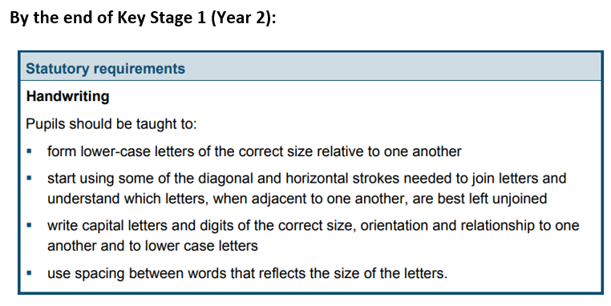
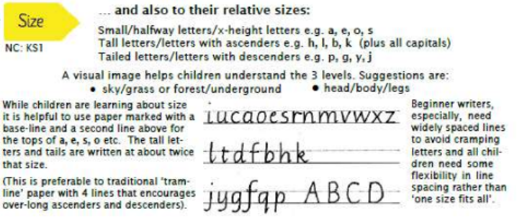
Handwriting
The National Curriculum Programme of Study (which it statutory!) states the following for schools:

Slide 20
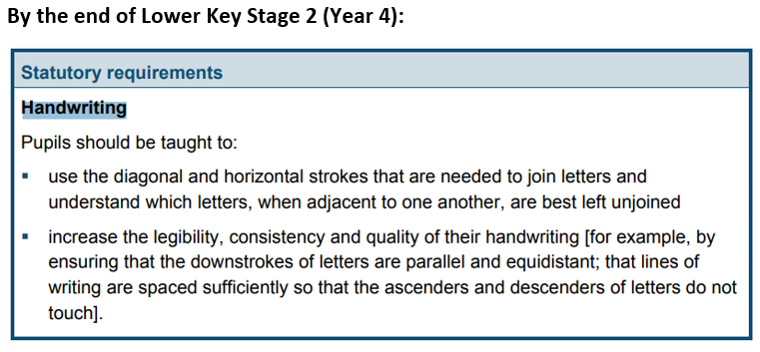
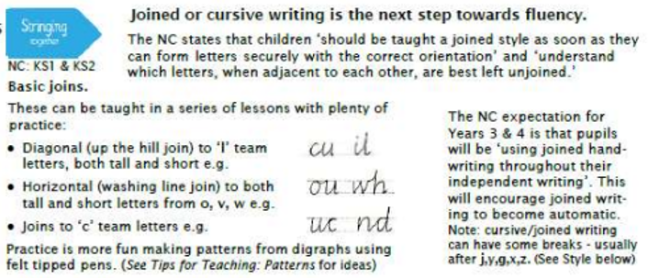
Handwriting Cont’d

Slide 21
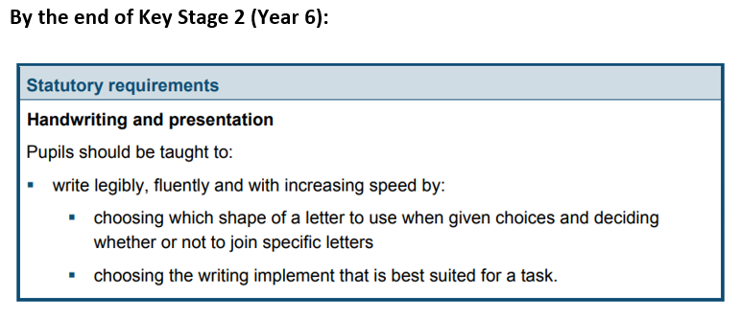
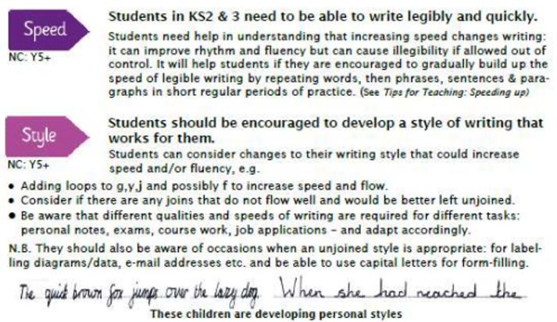
Handwriting Cont’d

