Slide 1


Special Mentions
Date: 18.09.26
A focus on: Respect

Slide 2
Our Achiever of the Week & Behaviour for Learning in Oak Class.
Achiever of the Week:
All of the children in Oak Class have had a fantastic first full week of school. They have listened carefully and followed their instructions.

Slide 3
Our Achiever of the Week & Behaviour for Learning in Ash Class.
Achiever of the Week:
Florence B for writing fantastic sentences about the caterpillar from Alice in Wonderland.
Behaviour for Learning of the Week:
Florence G for always listening and showing our 3 respect rules.
Superstar Readers
Hugo for using his Fred talk to sound out words.

Slide 4
Our Achiever of the Week & Behaviour for Learning in Maple Class.
Achiever of the Week:
Joe G has applied himself in all areas of learning and embraced year 2.
Behaviour for Learning of the Week:
Harry T has shown a positive attitude to his learning this week – well done!
Superstar Readers
Dawson for great partner reading in Vipers.
Gracie for reading at home and great retrieval skills.

Slide 5
Our Achiever of the Week & Behaviour for Learning in Willow Class.
Achiever of the Week:
Ernest has had a fantastic start to Year 4 – showing focus and enthusiasm in his learning. Well done!
Behaviour for Learning of the Week:
Zara has shown kindness to her friends this week and thankfulness to the adults in school – kind, considerate and lovely manners.
Superstar Readers
Grace has read regularly at home and is a role model in our class for a love of books!

Slide 6
Our Achiever of the Week & Behaviour for Learning in Birch Class.
Achiever of the Week:
Evie for excellent oral contributions to class
discussions.
Behaviour for Learning of the Week:
Elliot for always being on task and
demonstrating excellent presentation,
handwriting and pencil grip.
Superstar Readers
Jacob for enthusiastic engagement in our
'Read-Off'.

Slide 7
P.E. / Sports
Award
Alice C for fantastic P.E skills and listening well to instruction.

Slide 8
Headteacher's
Award
Headteacher
Award
My special mentions this week go to:
To all the Year 6 Students for being fantastic buddies to the reception children.

Slide 9
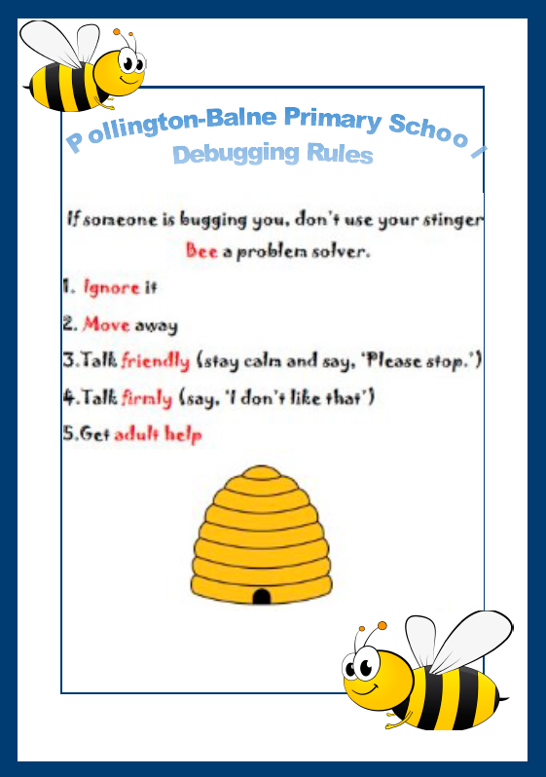
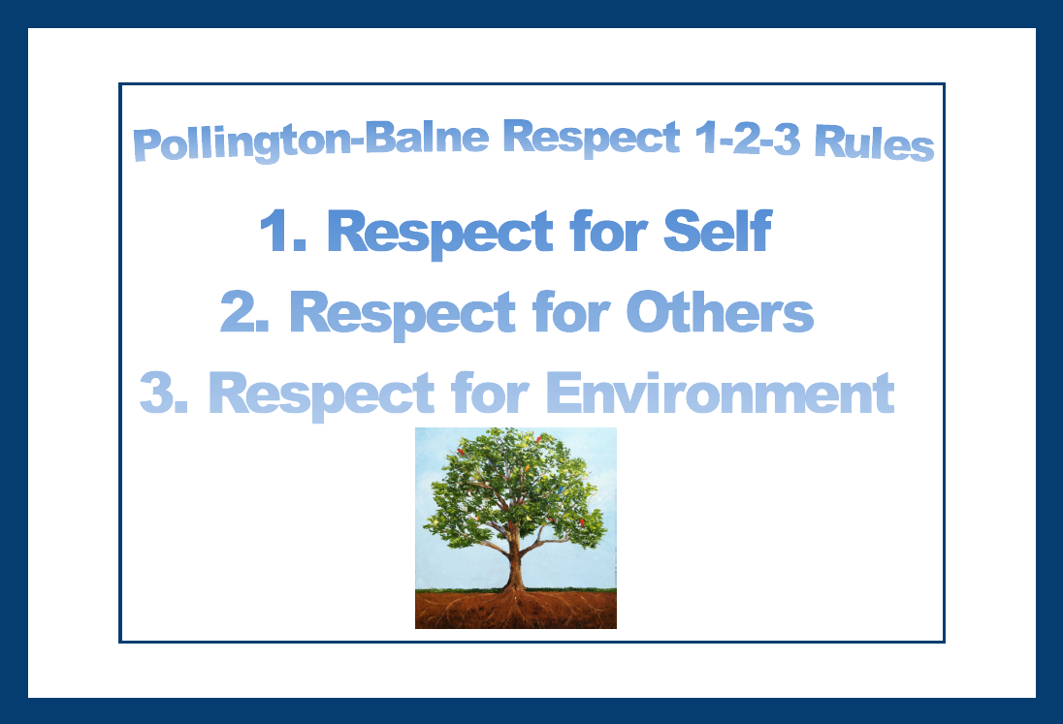
Next week’s focus….
Respect for others rule.

