Slide 1





Special Mentions
Date: 09.01.2025
A focus on: courage

Slide 2
Our Achiever of the Week & Behaviour for Learning in Oak Class.
S
Achiever of the Week:
Alfie for amazing subitising in Maths.
Behaviour for Learning of the Week:
Spencer for an improved attitude towards his
work.
Superstar Readers
Kian for fantastic reading using Fred Talk.
Presley for fantastic reading using Fred Talk.

Slide 3
Our Achiever of the Week & Behaviour for Learning in Ash Class.
Achiever of the Week:
Harry T for showing postivity and independence in his learnng this week.
Behaviour for Learning of the Week:
Harry P has shown fantastic focus and a great attitude this week to his learning
Superstar Readers
Cicely for using expression in her reading.
Zara for reading at home and working on her fluency.

Slide 4
Our Achiever of the Week & Behaviour for Learning in Maple Class.
ØAchiever of the Week:
Hilda for challenging herself during our science lesson, adding an extra living thing to her classification table without being prompted
Oliver for impressive imagination and description in our writing this week
ØBehaviour for Learning of the Week:
Teddy and Harry for their fantastic artwork concentrating when developing their drawing skills –particulary drawing distance and even challenged themselves to overlap objects in their drawing
ØSuperstar Readers
Ernie for excellent prediction answers during our vipers lesson

Slide 5
Our Achiever of the Week & Behaviour for Learning in Willow Class.
Achiever of the Week:
Ben has worked hard this year on his timestables and in our Numbersense session- his confidence and scores are improving.
Behaviour for Learning of the Week:
Evelyn has had a great start to the new term – a positive attitude to her learning, working well with her peers and overall focus and drive.
Superstar Readers
Jemima has shown a hardworking attitude to our paired reading sessions in class – Well done!

Slide 6
Our Achiever of the Week & Behaviour for Learning in Birch Class.
Achiever of the Week:
Annie for outstanding understanding of ratio and supporting others and herself by using manipulatives when necessary.
Behaviour for Learning of the Week:
Lennon for showing a positive attitude to learning throughout the week challenging himself in arithmetic and making profound predictions in reading.
Superstar Readers
William for expressive reading in VIPERS.

Slide 7
P.E. / Sports
Award
Bernard – for excellent sportsmanship and effort during the target game.

Slide 8
Headteacher's
Award
My special mentions this week go to:
Agnes - fabulous recall of epiphany service and the meaning of Epiphany and why the three wise men took gifts (naming them!)
Sebby – for explaining why we write 20+C+M+B+26 in chalk outside our homes

Slide 9
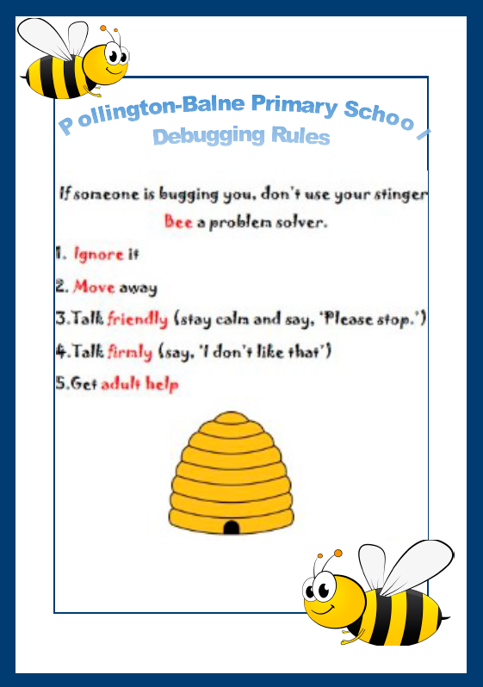
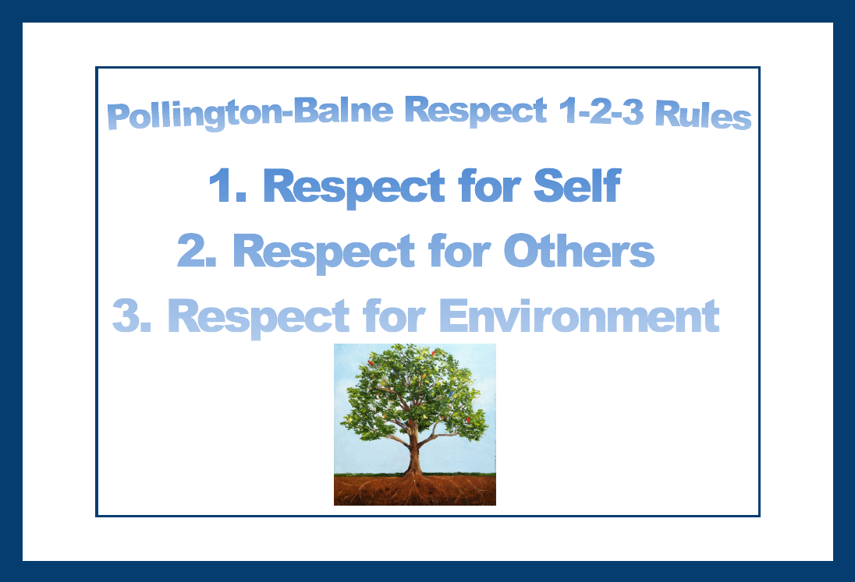
Next week’s focus….
Respect for others rule.

