Slide 1





Special Mentions
Date: 16.01.2025
A focus on: courage

Slide 2
Our Achiever of the Week & Behaviour for Learning in Oak Class.
S
Achiever of the Week:
Hugo for fantastic maths work this week finding one more and one less.
Behaviour for Learning of the Week:
Isaac for always being ready to listen and learn.
Superstar Readers
Joe for answering questions about what he has read.
Reys for using fantastic Fred Talk.

Slide 3
Our Achiever of the Week & Behaviour for Learning in Ash Class.
Achiever of the Week:
Violet who has shown courage and independence in her learning and sharing her ideas.
Behaviour for Learning of the Week:
Joseph has shown a fantastic attitude to all areas of his learning and has also supported his peers.
Superstar Readers:
Theo S for reading at home and showing great effort in his phonics group.
Grace D for reading every day at home and applying fantastic expression in her reading.

Slide 4
Our Achiever of the Week & Behaviour for Learning in Maple Class.
ØAchiever of the Week:
Myles for his excellent participation and ideas during our writing lesson.
ØBehaviour for Learning of the Week:
Henry A.W and Oliver, for helping and supporting their peer during P.E.
ØSuperstar Readers:
Olivia for lovely paired reading during our vipers lesson and helping her partner.

Slide 5
Our Achiever of the Week & Behaviour for Learning in Willow Class.
Achiever of the Week:
Both Immy and Hilda have done really well transitioning into Willow Class – you have shown such a positive and hardworking attitude to your learning and you have settled in very well.
Behaviour for Learning of the Week:
Jemima and Amelie both displayed great leadership and teamwork this week in Forest School – working hard during the session and setting a great example.
Superstar Readers:
All of Willow Class! I am so proud of you all for your engagement in our 'Stay and Read' session. It was lovely to see you showing a love of reading and sharing your books with an adult – Well done!

Slide 6
Our Achiever of the Week & Behaviour for Learning in Birch Class.
Achiever of the Week:
Finlay for excellent contributions to
mathematical and scientific discussions.
Behaviour for Learning of the Week:
Ellie for always striving to improve her work
and never 'settling'.
Superstar Readers
Joseph for enjoying sharing extracts from his
book.

Slide 7
P.E. / Sports
Award
P.E. star of the week:​
Arthur L - For great bean bag target shots.
Elliot B - For a 3 star award challenge.
Florence B - For working really hard with her team.
​
​

Slide 8
Headteacher's
Award
My special mentions this week go to:
Lottie, Sebby, Zadie, Harper, Arthur, Oliver W, Jemima, Harrison M, Grace J & Archie W.
For a fabulous welcome and excellent questioning when Bishop Leah came to visit.

Slide 9
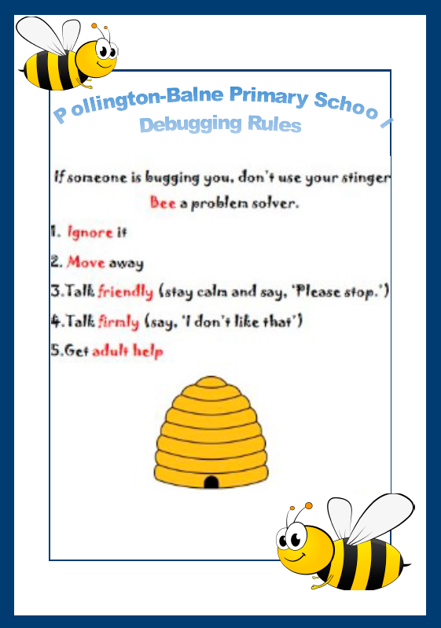

Next week’s focus….
Respect for others rule.

