Slide 1
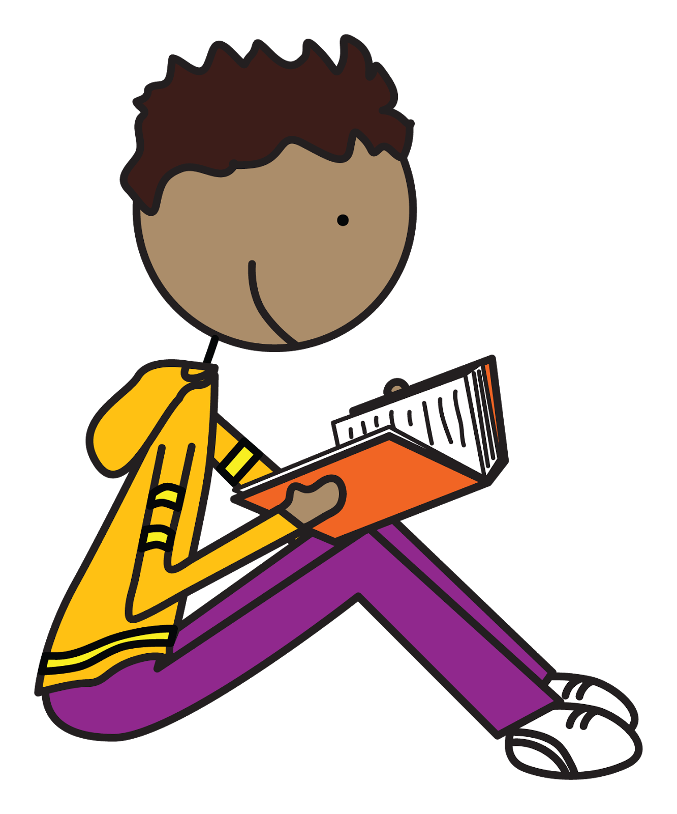




Spellings
Week 2
Y2
12.9.25
Look Read Cover Write Check | Monday | Tuesday | Wednesday | Thursday
door
floor
poor
find
mind
kind
Spelling knowledge:
Common Exception words.

Slide 2
Spellings
Week 3
Y2
19.9.24
Look Read Cover Write Check | Monday | Tuesday | Wednesday | Thursday
cold
old
gold
hold
told
behind
Spelling knowledge:
Common exception words for Year 2.

Slide 3
Spellings
Week 4
Y2
26.9.25
Look Read Cover Write Check | Monday | Tuesday | Wednesday | Thursday
could
would
should
class
grass
pass
Spelling knowledge:
Common exception words for Year 2.

Slide 4
Spellings
Week 5
Y2
3.10.25
Look Read Cover Write Check | Monday | Tuesday | Wednesday | Thursday
great
break
steak
fast
last
past
Spelling knowledge:
Common exception words for Year 2.

Slide 5
Spellings
Week 6
Y2
10.10.25
Look Read Cover Write Check | Monday | Tuesday | Wednesday | Thursday
path
bath
child
children
wild
climb
Spelling knowledge:
Common exception words for Year 2.

Slide 6
Spellings
Week 7
Y2
17.10.25
Look Read Cover Write Check | Monday | Tuesday | Wednesday | Thursday
every
everybody
even
Mr
Mrs
parents
Spelling knowledge:
Common exception words for Year 2.

Slide 7
Spellings
Week 8
Y2
23.10.25
Look Read Cover Write Check | Monday | Tuesday | Wednesday | Thursday
improve
sure
sugar
who
whole
any
Spelling knowledge:
Common exception words (these link to Read, Write Inc ‘red’ words) are not decodable with the phonics the children have learned so far. These are best learned by sight, practise and in their reading

Slide 8
Spellings
Week 9
Y2
7.11.25
Look Read Cover Write Check | Monday | Tuesday | Wednesday | Thursday
because
pretty
beautiful
after
father
plant
Spelling knowledge:
Common exception words (these link to Read, Write Inc ‘red’ words) are not decodable with the phonics the children have learned so far. These are best learned by sight, practise and in their reading

Slide 9
Spellings
Week 10
Y2
14.11.25
Look Read Cover Write Check | Monday | Tuesday | Wednesday | Thursday
many
clothes
busy
people
water
again
Spelling knowledge:
Common exception words (these link to Read, Write Inc ‘red’ words) are not decodable with the phonics the children have learned so far. These are best learned by sight, practise and in their reading

Slide 10
Spellings
Week 11
Y2
21.11.25
Look Read Cover Write Check | Monday | Tuesday | Wednesday | Thursday
knock
know
knee
gnaw
gnome
gnarled
Spelling knowledge:
As part of our spellings, we revisit and reinforce the spelling strategies taught in phonics.
This week:
The sounds /n/ spelt 'kn' and less often, 'gn' at the beginning of words.

Slide 11
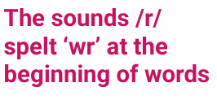
Spellings
Week 12
Y2
28.11.25
Look Read Cover Write Check | Monday | Tuesday | Wednesday | Thursday
write
written
wrote
wrong
wrist
wreck
Spelling knowledge:
As part of our spellings, we revisit and reinforce the spelling strategies taught in phonics.

Slide 12
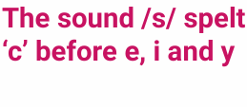
Spellings
Week 13
Y2
5.12.25
Look Read Cover Write Check | Monday | Tuesday | Wednesday | Thursday
race
ice
city
fancy
circle
bicycle
Spelling knowledge:
As part of our spellings, we revisit and reinforce the spelling strategies taught in phonics.

