Slide 1

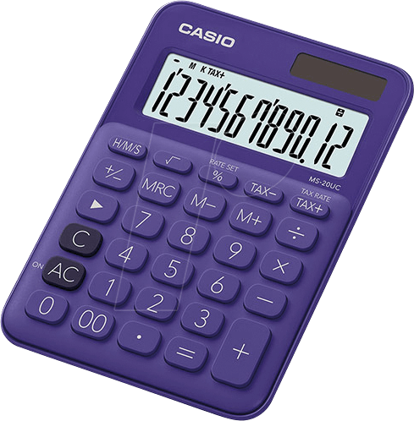

Ash Class Homework
Set: Friday 26th September 2025
Return: Friday 10th October 2025
MATHEMATICS
We been looking at different ways of partitioning numbers.
Year 1: Can you use your knowledge to find different ways of making 20?
Year 2: Can you use your knowledge to find different ways of making 50?
WRITING
We have been reading the text, 'Look up!' By Nathan Byron.
Whilst reading it, have also talked about what it would be like in Space and all the things we might see.
If you would like to, have a go at writing about your own imaginary space journey.
Where will you go, what will you see?
Remember your capital letters and full stops!
READING
EXTRAS
In Science, we are focusing upon Seasons.
Can you find something that represents our Autumn Season?
Have you noticed any changes now that Summer has ended?
If you find anything on your walks or in your garden, please bring them in.
Read every day to an adult for at least ten minutes and write it in your reading diary.
Who else might like to hear you read to them?
Your teddy?
Your brothers and sisters?
Your pets?
I'd love to see your reading photos!

