Slide 1
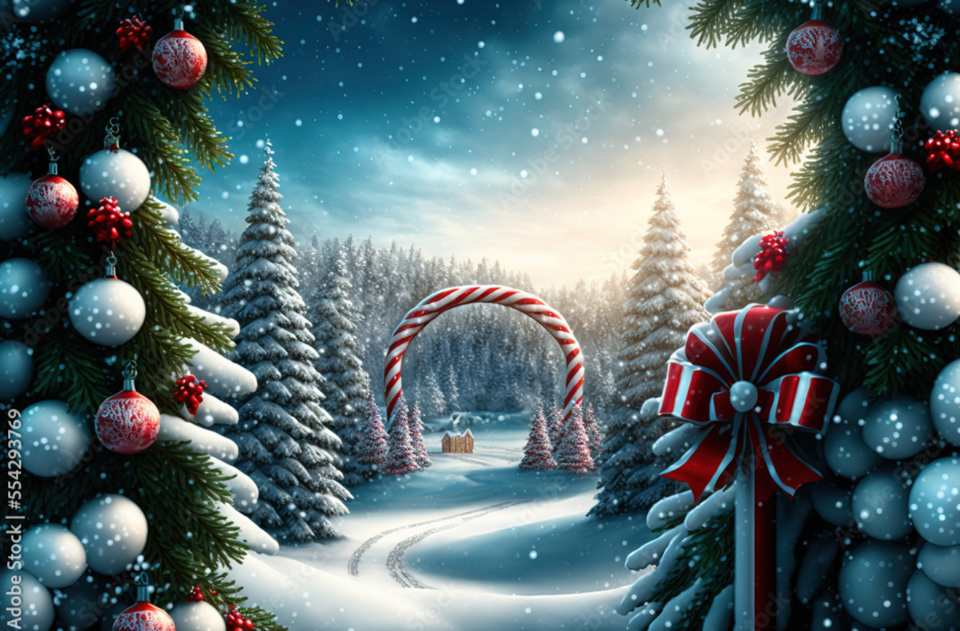
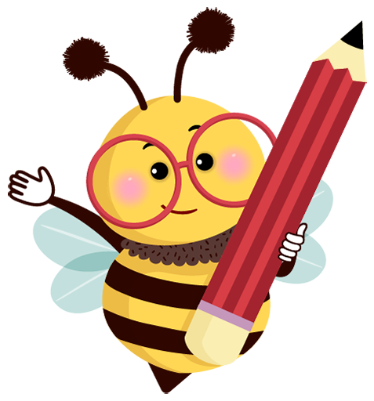
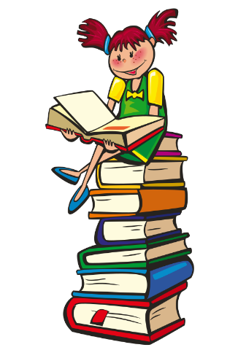
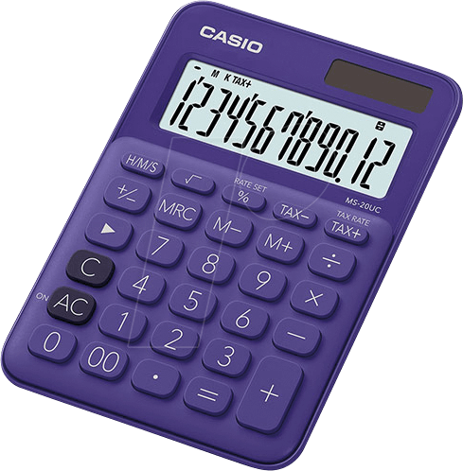

Ash Class Homework
Set: Friday 5th December 2025
Return: Friday 9th January 2026
MATHEMATICS
Are the following statements about number always true, sometimes true or never true?
When you add 10 to a number,
the answer is a multiple of 10
If you put two squares together
you get a rectangle
Four sided shapes are called squares
WRITING
As we approach Christmas, can you create your own Christmas story, using the picture as your inspiration?
READING
EXTRAS
We will soon be beginning the year 2026.
What will
your New Year's Resolution be?
Can you think of any targets you could set yourself for 2026?
For example, try and improve your handwiritng or learn your times tables?
Read every day to an adult for at least ten minutes.
Our reading focus this week is to read with expression, especially when a character is speaking.
Remember to write it in your diary and bring your reading diary into school every day.

