Slide 1


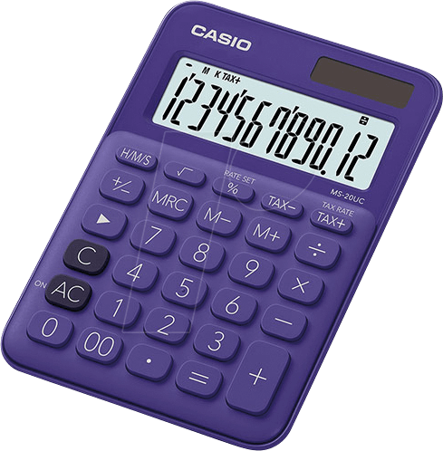

Ash Class Homework
Set: Friday 7th November2025
Return: Friday 21st November 2025
MATHEMATICS
Choose a number between 0 and 50. Count forward three times in tens.
Do 5 examples of this.
Eg; 45, 55, 65 ,75
32, 42, 52, 62
Practise counting in multiples of ten.
10,20,30,40,50,60,70,80,90,
100
WRITING
We have been focusing on adjectives in our writing.
Think of an animal — any animal you like!
Make up a silly or funny sentence about that animal.
What is it doing?
Where is it?
What does it look like?
Write one or two sentences and draw a picture to match.
Example:
The pink elephant is dancing in the kitchen!
READING
EXTRAS
Talk to your adults about the word ‘proud’.
What makes you feel proud?
Draw a picture of someone or something that makes you feel proud.
This could be an achievement, an award or an event.
Read every day to an adult for at least ten minutes.
Can you find any adjectives in your books?
Year 1: Can you write a sentence using the adjectives you have found,
Year 2: Can you find 2 synonyms for the adjectives?

